Slide 1
Capstone Project - Car accident severity report
Pavithra Kannan
30/9/2020

Slide 2
Collision Data Seattle Police Department
It is important to understand the collision data to predict the severity of collision.
In United states of America, in the year 2018, there were around 40,000 deaths, 4.5 million injuries and 10 million dollars in property damage associated with vehicular accidents.
The data obtained is from Seattle Police Department (SPD) recorded by Traffic Records

Slide 3
Data Acquisition and cleaning
The data was sourced from SPD recorded by Traffic Records. The data consisted of around 37 attributes and 194,673 rows consisting of various factors recorded by SPD.
Upon studying the data, "SEVERITYCODE" is the is the target variable. It is the attribute that corresponds to the severity of the collision.
The data as it is was not fit for analysis
Attributes that contribute to the severity of the accidents according to me are
* "WEATHER" - A description of the weather conditions during the time of the collision
* "ROADCOND" - The condition of the road during the collision
* "LIGHTCOND" - The light conditions during the collision

Slide 4
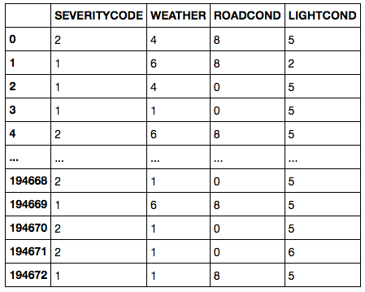
Methodology
Cleaning of Data
Label Encoding of object data type to Numeric

Slide 5


Methodology
Target feature was in imbalance by almost three times
Used statistical technique to balance it.

Slide 6
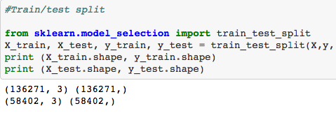
Methodology
Split the data set into training and predicting
Now various models were applied to the data set

Slide 7
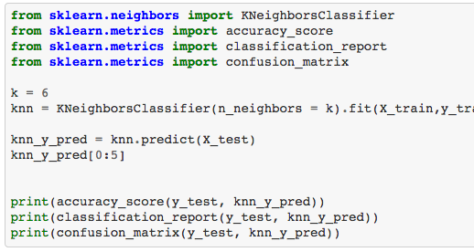
KNN Method

Slide 8
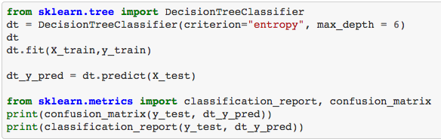
Decision Tree

Slide 9
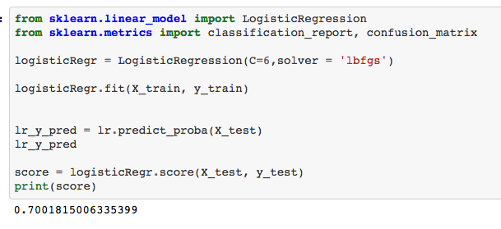
Logistic Regression

Slide 10
Result
The accuracy of our models is as below
Based on the above table, all the three models give the same accuracy.
NO | Model Name | Accuracy
1 | KNN | 0.70
2 | Decision Tree | 0.70
3 | Linear Regression | 0.70

